Slide 1
SQL Crash Course

Slide 2
OO vs Relational Models
Person
______________
name
phone
email
person
name | phone | email
Joe | 12121212 | joe@email.com
Jane | 11221122 | jane@email.com
Janice | 33443344 | janice@email.com
:Person
_____________________
name = “Joe”
phone = 12121212
email = “joe@email.com”
:Person
________________________
name = “Janice”
phone = 33443344
email = “janice@email.com”
:Person
______________________
name = “Jane”
phone = 11221122
email = “jane@email.com”

Slide 3
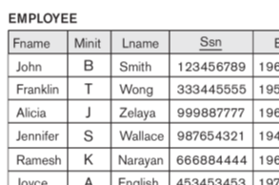

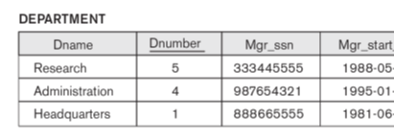
Relational Databases – Crash Course
All data in tables.
All rows have a primary key.
Tables may refer to other tables by foreign keys that point to primary keys in other tables.

Slide 4
person
Person
______
id
name
phone
email
Dog
______
id
name
feeYear
id | name | phone | email
1 | Joe | 12121212 | joe@email.com
2 | Jane | 11221122 | jane@email.com
3 | Janice | 33443344 | janice@email.com
*
:Person
_____________________
name = “Joe”
phone = 12121212
email = “joe@email.com”
dogs =
dog
id | name | feeYear | person_id
1 | Rex | 2018 | 1
2 | Rolex | 2018 | 1
3 | Ronny | 2017 | 3
:Dog
___________
id = 1
name = “Rex”
phone = 2018
:Dog
___________
id = 2
name = “Rolex”
phone = 2018

Slide 5
Company Database

Slide 6
Company Database

Slide 7
Company Database

Slide 8
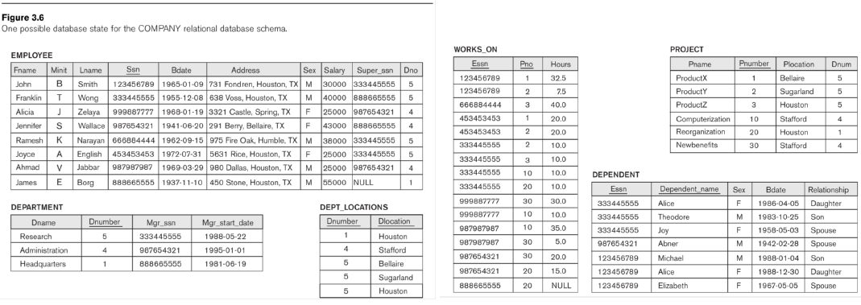
Company Database
File: Figure_5_6_all.pdf

Slide 9

Exercises
Company Exercise
Do

